Slide 1
Chapter 4: The Accounting Cycle
Financial & Managerial Accounting, 16e

Slide 2
Financial Statements (Learning Objective 2)
Using the adjusted trial balance, the financial statements can be prepared.
The income statement
The statement of stockholders’ equity
The balance sheet

Slide 3
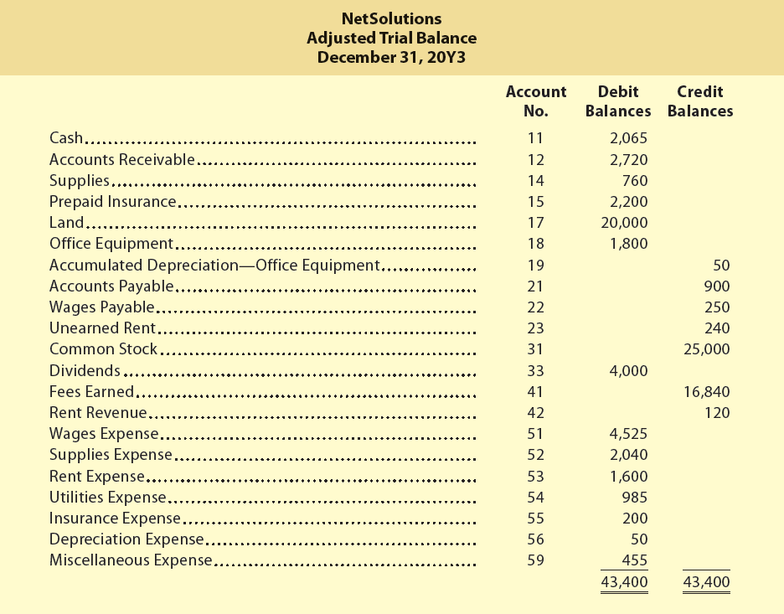
Exhibit 9 – Adjusted Trial Balance

Slide 4
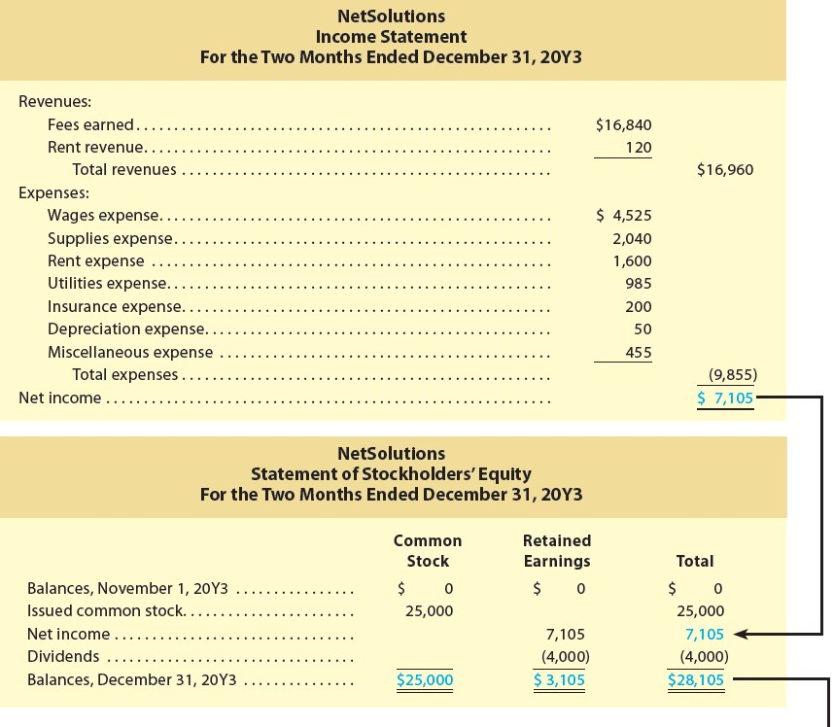
Exhibit 2 – Financial Statements—NetSolutions (1 of 2)

Slide 5
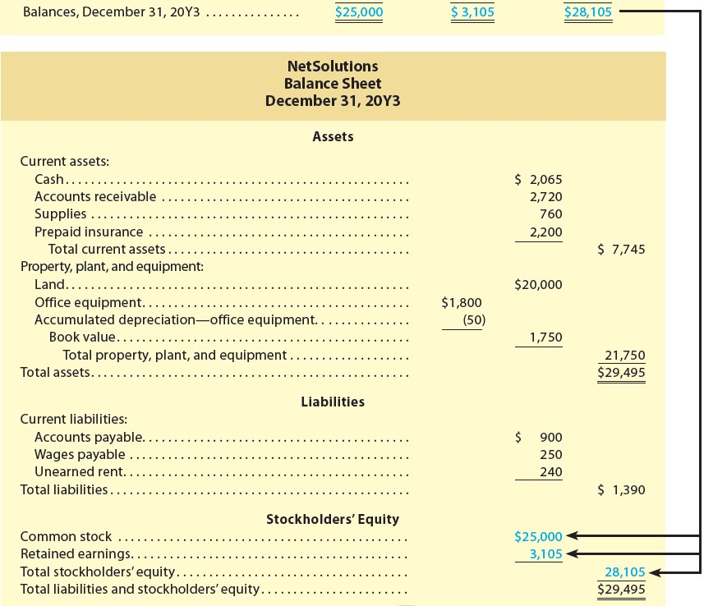
Exhibit 2 – Financial Statements—NetSolutions (2 of 2)

Slide 6
Income Statement
The income statement is prepared directly from the Adjusted Trial Balance columns spreadsheet, beginning with fees earned.
The expenses in the income statement are listed in order of size, beginning with the larger items.
Miscellaneous expense is the last item, regardless of its amount.

Slide 7
Statement of Stockholders’ Equity (1 of 2)
The statement of stockholders’ equity is prepared by entering the beginning balances for common stock and retained earnings.
The common stock that was issued during the period is entered in the Common Stock column.
During the period, earned net income increases retained earnings and is therefore entered in the Retained Earnings column.
Paid dividends during the period, which reduces retained earnings and is therefore entered as a deduction in the Retained Earnings column.
Entries in each row are added across and the total is entered in the Total column.
Finally, all of the columns are totaled to arrive at the ending balances for Common Stock and Retained Earnings and the total of stockholders’ equity as of December 31, 20Y3.

Slide 8
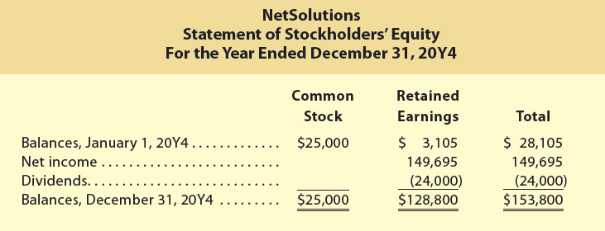
Statement of Stockholders’ Equity (2 of 2)
For the following period, the beginning balances of Common Stock and Retained Earnings are the ending balances that were reported for the previous period.
The statement of stockholders’ equity for the year ending December 31, 20Y4, for NetSolutions would be as follows:

Slide 9
Balance Sheet
The balance sheet is prepared directly from the Adjusted Trial Balance columns of the spreadsheet, beginning with cash.
The asset and liability amounts are taken from the spreadsheet.
The common stock and retained earnings amounts are taken from the statement of stockholders’ equity.
The balance sheet shows subsections for assets and liabilities.
Such a balance sheet is a classified balance sheet.

Slide 10
Assets
Assets are commonly divided into two sections on the balance sheet:
Current assets are cash and other assets that are expected to be converted to cash or sold or used up usually within one year or less, through the normal operations of the business.
Notes receivable and accounts receivable are amounts that customers owe.
Property, plant, and equipment may also be described as fixed assets or plant assets.
These assets include equipment, machinery, buildings, and land.

Slide 11
Liabilities and Shareholders’ Equity
Liabilities are the amounts the business owes to creditors. Liabilities are commonly divided into two sections on the balance sheet:
Current liabilities are liabilities that will be due within a short time (usually one year or less) and that are to be paid out of current assets.
Long-term liabilities are liabilities that will not be due for a long time (usually more than one year).
The stockholders’ right to the assets of the business is presented on the balance sheet below the Liabilities section as shareholders’ equity.

Slide 12
Statement of Cash Flows
While the income statement, statement of stockholders’ equity, and balance sheet can be prepared from the Adjusted Trial Balance columns, the statement of cash flows is prepared by analyzing the cash account.
In doing so, each cash transaction is classified as an operating, investing, or financing activity.
In practice, however, the statement of cash flows is normally prepared using a different, more complex method called the indirect method.

Slide 13
NOT ON THE EXAM AFTER THIS SLIDE- Closing Entries (1 of 3) (Learning Objective 3)
The balances of the accounts reported on the balance sheet are carried forward from year to year.
Because they are relatively permanent, these accounts are called permanent accounts or real accounts.
The balances of the accounts reported on the income statement are not carried forward from year to year.
The balance of the dividends account, which is reported on the statement of stockholders’ equity, is not carried forward.
Because these accounts report amounts for only one period, they are called temporary accounts or nominal accounts.
Temporary accounts are not carried forward because they relate only to one period.

Slide 14
Closing Entries (2 of 3)
At the beginning of the next period, temporary accounts should have zero balances.
To achieve this, temporary account balances are transferred to permanent accounts at the end of the accounting period.
The journal entries that transfer these balances are called closing entries.
The transfer process is called the closing process and is sometimes referred to as closing the books.

Slide 15
Closing Entries (3 of 3)
The closing process involves the following two steps:
Step 1. Revenue and expense account balances are transferred to the retained earnings account.
Step 2. The balance of the dividends account is transferred to the retained earnings account.
The two closing journal entries required by the closing process are as follows:
Closing Entry (1): Debit each revenue account for its balance, credit each expense account for its balance, and credit (net income) or debit (net loss) the retained earnings account.
Closing Entry (2): Debit the retained earnings account for the balance of the dividends account and credit the dividends account for its balance.
Closing entries are recorded in the journal and are dated as of the last day of the accounting period.

Slide 16
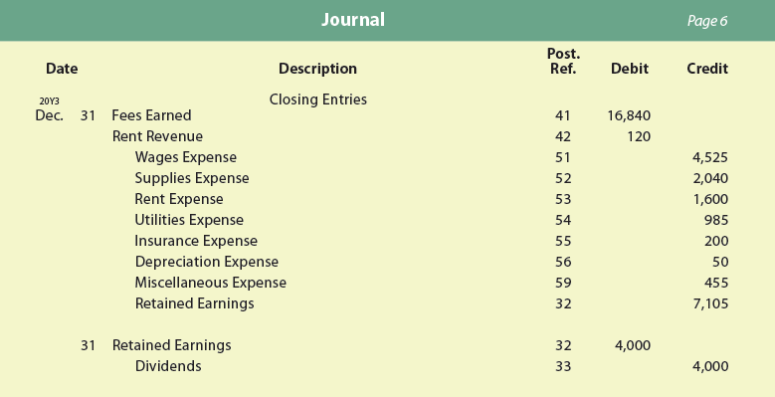
Exhibit 5 – Closing Entries, NetSolutions

Slide 17
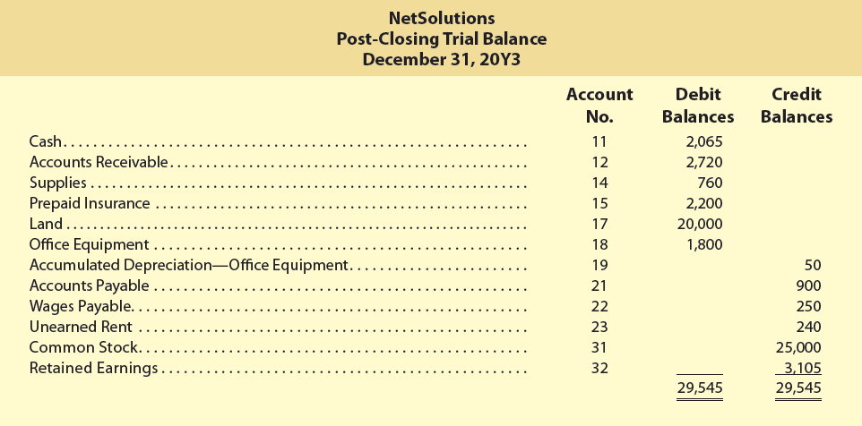
Exhibit 7 – Post-Closing Trial Balance, NetSolutions
Notes:
A post-closing trial balance is prepared after the closing entries have been posted.
The purpose of the post-closing (after closing) trial balance is to verify that the ledger is in balance at the beginning of the next period.
The accounts and amounts should agree exactly with the accounts and amounts listed on the balance sheet at the end of the period.

